Slide 1
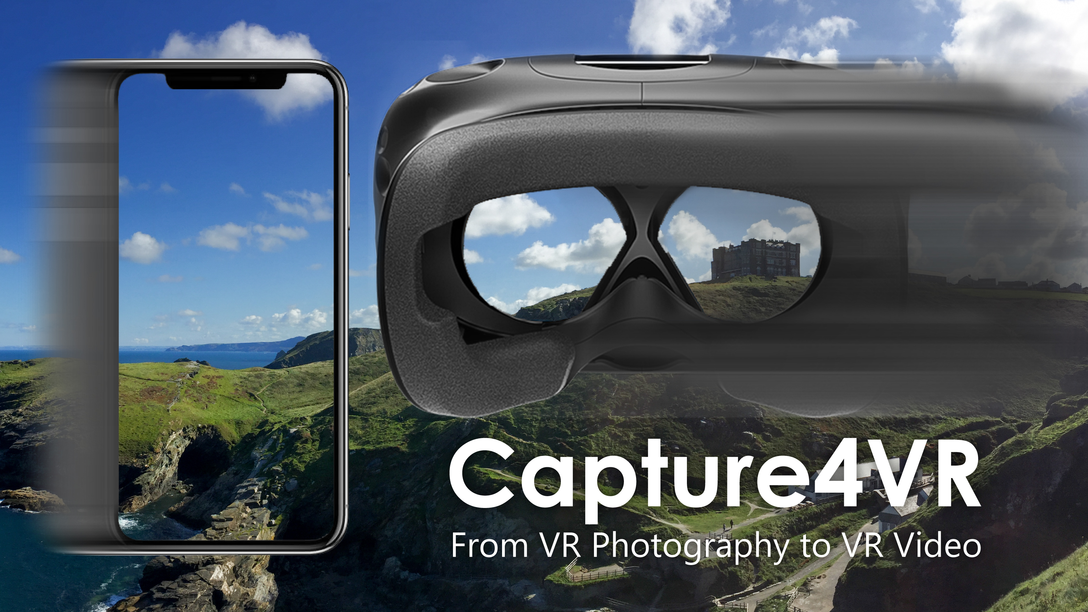
richardt.name/Capture4VR
Notes:
Welcome to our course …
You can find our slides on our course website at Richardt.name/Capture4VR, or simply search for “Capture4VR”.

Slide 2
Copyright notice
Permission to make digital or hard copies of part or all of this work for personal or classroom use is granted without fee provided that copies are not made or distributed for profit or commercial advantage and that copies bear this notice and the full citation on the first page. Copyrights for third-party components of this work must be honored. For all other uses, contact the owner/author(s).
SIGGRAPH 2019 Courses, July 28 – August 1, 2019, Los Angeles, CA, USA
© 2019 Copyright held by the owner/author(s).
ACM ISBN 978-1-4503-6307-5/19/07.
https://doi.org/10.1145/3305366.3328028

Slide 3
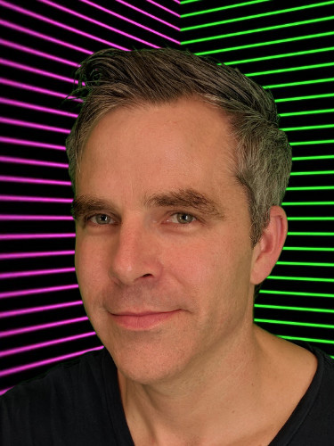
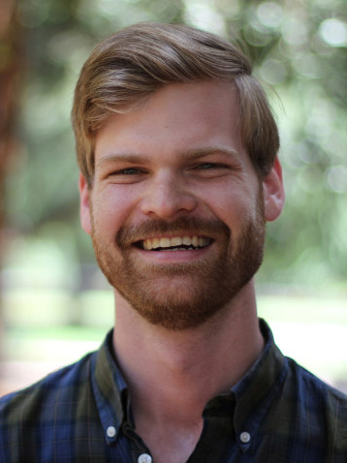
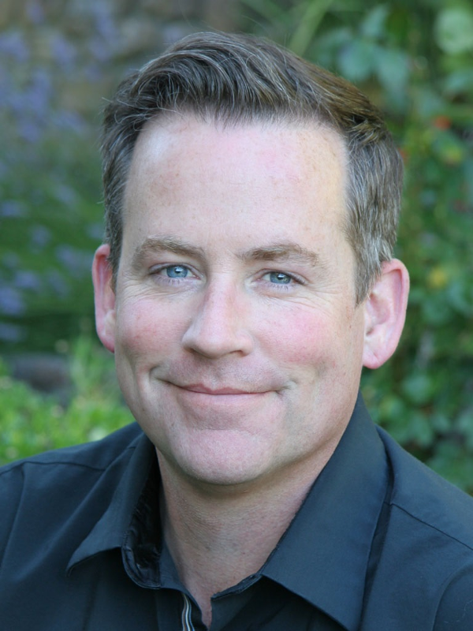
Who are we?
Christian Richardt
Peter Hedman
Ryan S. Overbeck
Brian Cabral
Robert Konrad
Steve Sullivan
Notes:
Christian Richardt – Associate Professor & EPSRC-UKRI Innovation Fellow at the University of Bath
Peter Hedman – a finishing PhD student at University College London who will soon join Google
Ryan S. Overbeck – staff software engineer at Google in San Francisco
Brian Cabral – Director of Engineering at Facebook
Robert Konrad – fifth-year PhD candidate at Stanford University, advised by Gordon Wetzstein
Steve Sullivan – leads the Mixed Reality Capture Studios program at Microsoft

Slide 4
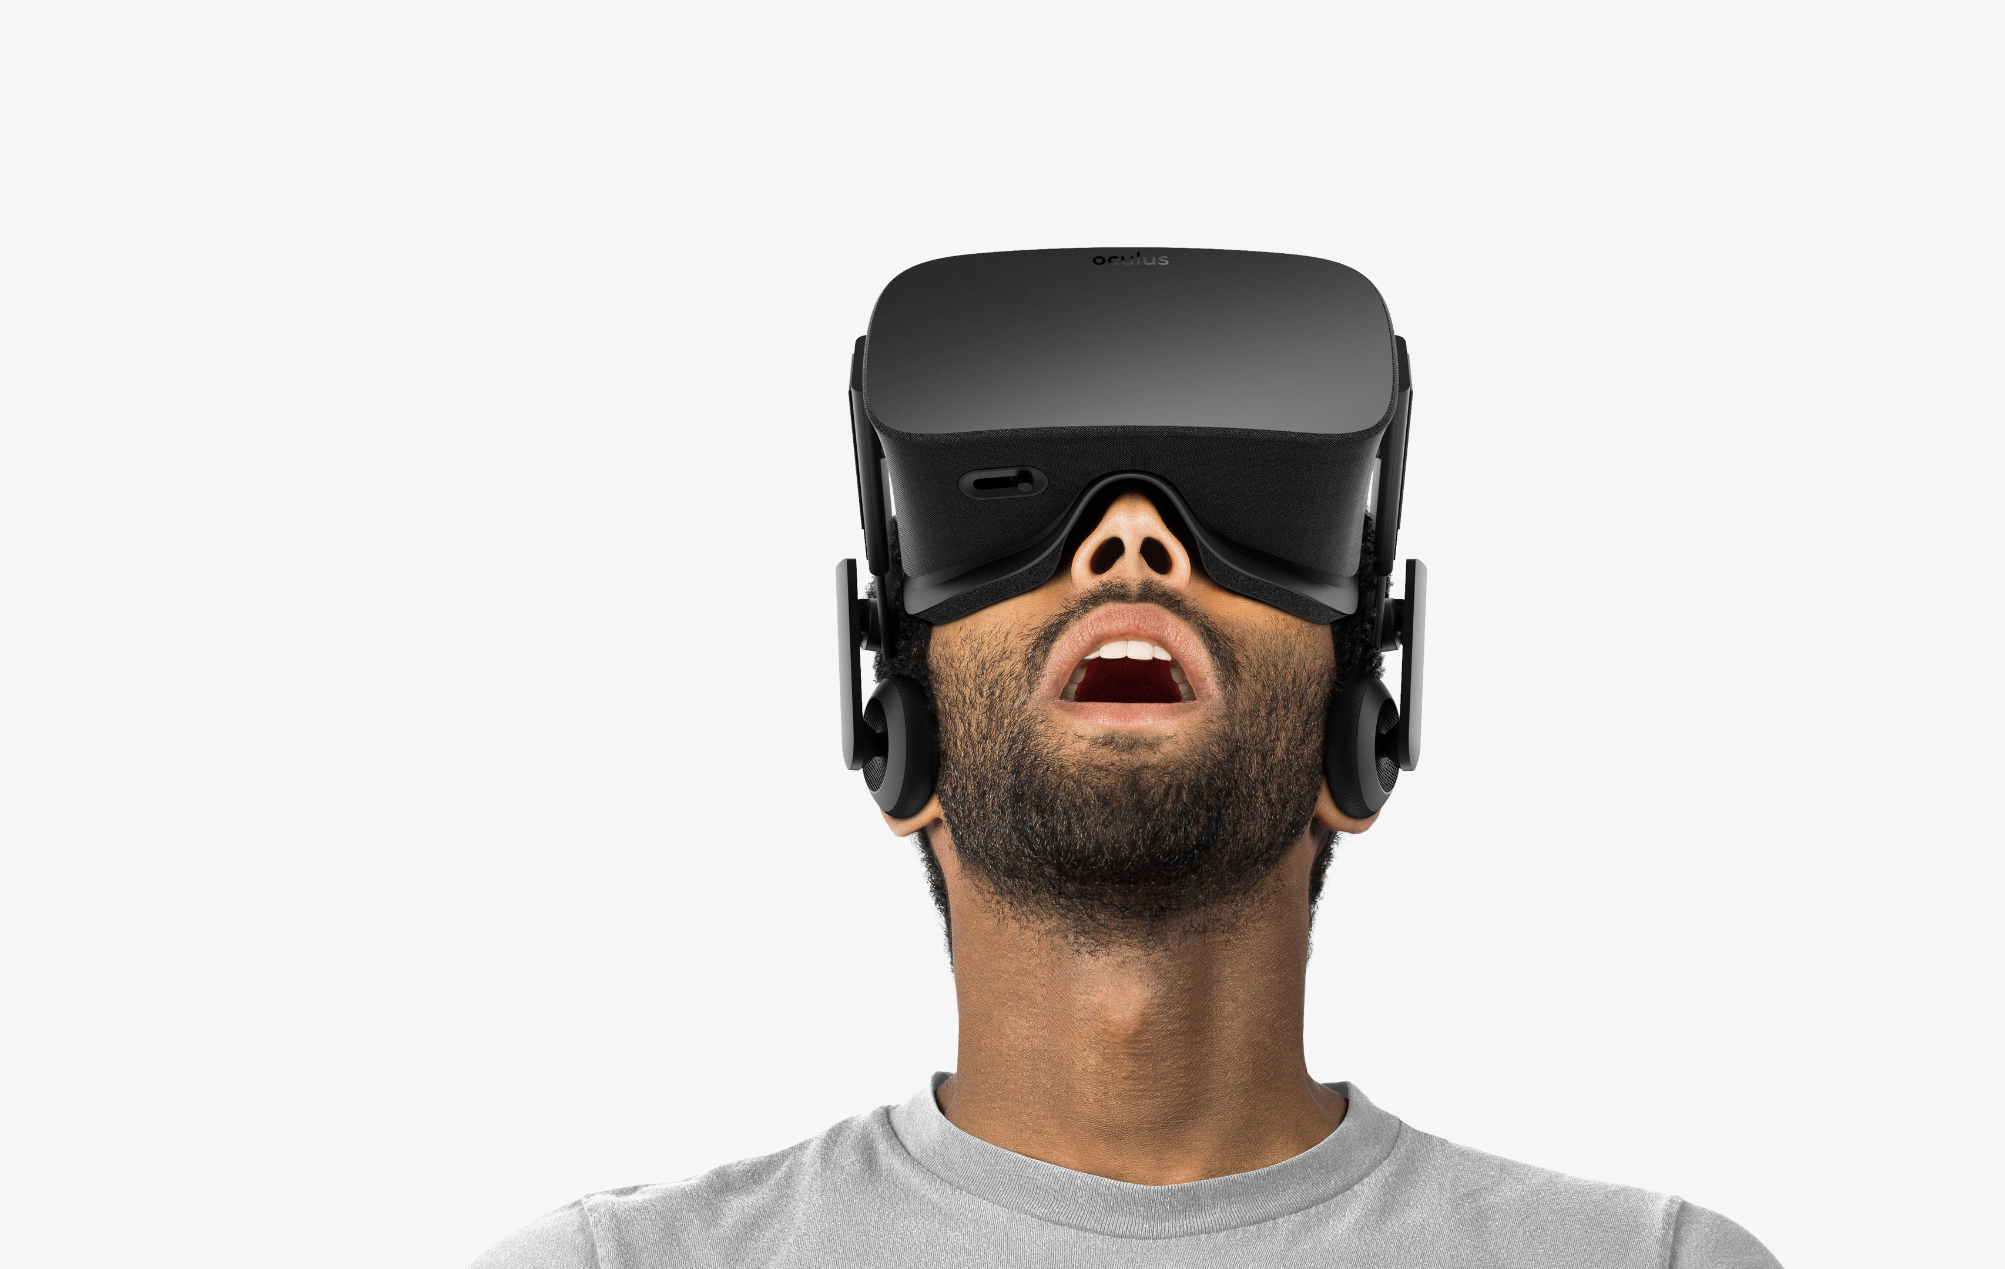
Virtual reality
Offers unparalleled immersion
Still a young medium
We need new ways:
to author content
to capture from the real world
In this course, we:
provide an overview of progress in VR photography and VR video
discuss state-of-the-art systems by Facebook, Google + Microsoft
Oculus
Notes:
As you know, Virtual reality (VR) enables the display of dynamic visual content with @ unparalleled realism and immersion.
However, @ VR is also still a relatively young medium that @ requires new ways @ to author content, particularly for @ visual content that is captured from the real world.
In this course, we will provide a comprehensive overview of the latest progress in bringing photographs and videos into VR.
Ultimately, the techniques, approaches and systems we discuss aim to faithfully capture the visual appearance and dynamics of the real world and to bring it into virtual reality.
@ In this half-day course, we would like to take you @ on a journey from VR photography to VR video that began more than two centuries ago and which has accelerated tremendously in the last five years.
@ We discuss both commercial state-of-the-art systems by Google, Facebook and Microsoft, as well as the latest research techniques and prototypes.

Slide 5
Course schedule
Start |  | Topic | Speaker
14:00 | 1. | Introduction | Christian Richardt, Bath
14:20 | 2. | 360° (Stereo) Panoramas | Christian Richardt, Bath
14:40 | 3. | 3D Photography | Peter Hedman, UCL
15:00 | 4. | Light Field Photography | Ryan S. Overbeck
15:20 |  | Q&A + Break
15:35 | 5. | 360 and ODS Video | Brian Cabral, Facebook
15:55 | 6. | Live ODS Video | Robert Konrad, Stanford
16:15 | 7. | 6-DoF Video | Brian Cabral, Facebook
16:35 | 8. | MR Capture Studios | Steve Sullivan, Microsoft
16:55 | 9. | Conclusion + Q&A | All presenters
Notes:
Here is an overview of our schedule for today
20 minute talks
time for one or two quick questions when changing presenters
Q&A session in the middle with a short break, for which we have an exciting demo for you to try
And a closing Q&A session after the conclusion

Slide 6
1. Introduction
Welcome + introduction of co-presenters
Overview and structure of this course
A brief history of panoramas and stereoscopy
Christian Richardt

Slide 7
2. 360° (Stereo) Panoramas
Traditional panorama stitching
applications in consumer devices
Omnidirectional stereo (ODS) panoramas
Omnistereo
Megastereo
Panoramas with motion parallax
Parallax360
MegaParallax
Christian Richardt

Slide 8
3. 3D Photography
VR photography with textured 3D reconstructions from hand-held photos:
Casual 3D photography
Instant 3D Photography
More immersive exploration in VR:
enables full 6 degrees-of-freedom (6-DoF) head motion
allows users to look around freely in VR
Peter Hedman

Slide 9
4. Light field photography
Introduction to light fields
Google’s panoramic light fields:
capturing ~1000 photos of a scene
process using structure-from-motion and multi-view stereo
real-time rendering for VR HMDs
Extensions to light field video
DeepView:
view synthesis with multi-plane images
Ryan S. Overbeck

Slide 10
5. 360 and ODS video
Moving from still images to moving pictures
360° video
affordable consumer 360° cameras
but lacks depth
Omnidirectional stereo (ODS)
produces stereoscopic 360° video
but requires multi-camera rigs
e.g. Facebook Surround 360 or Google Jump
Brian Cabral

Slide 11
6. Live ODS video
ODS video approaches usually require expensive off-line processing
prevents live streaming
Overview of live streaming ODS:
live streaming ODS camera arrays
single-shot ODS systems
rotating systems for ODS capture
Robert Konrad

Slide 12
7. 6-DoF video
Need support for 6-DoF motion within VR video
so that viewers can move their head around freely to explore a scene
Facebook’s latest camera rigs and techniques:
x6, x24 and Manifold cameras
6-DoF video techniques and results
Brian Cabral

Slide 13
8. Microsoft Mixed Reality Capture Studios
We also want to capture objects realistically
e.g. people and animals
Volumetric video capture using outside-in camera arrangement
Microsoft Mixed Reality Capture Studios:
state-of-the-art commercial facilities
overview of underlying technology
‘holograms’ can be inserted into VR/AR experiences
Steve Sullivan

Slide 14
9. Conclusion + Q&A
Short summary
Discussion of remaining challenges towards ubiquitous 6-DoF VR photography and video
Questions & answers
Christian Richardt

Slide 15
Course schedule
Start |  | Topic | Speaker
14:00 | 1. | Introduction | Christian Richardt, Bath
14:20 | 2. | 360° (Stereo) Panoramas | Christian Richardt, Bath
14:40 | 3. | 3D Photography | Peter Hedman, UCL
15:00 | 4. | Light Field Photography | Ryan S. Overbeck
15:20 |  | Q&A + Break
15:35 | 5. | 360 and ODS Video | Brian Cabral, Facebook
15:55 | 6. | Live ODS Video | Robert Konrad, Stanford
16:15 | 7. | 6-DoF Video | Brian Cabral, Facebook
16:35 | 8. | MR Capture Studios | Steve Sullivan, Microsoft
16:55 | 9. | Conclusion + Q&A | All presenters

Slide 16
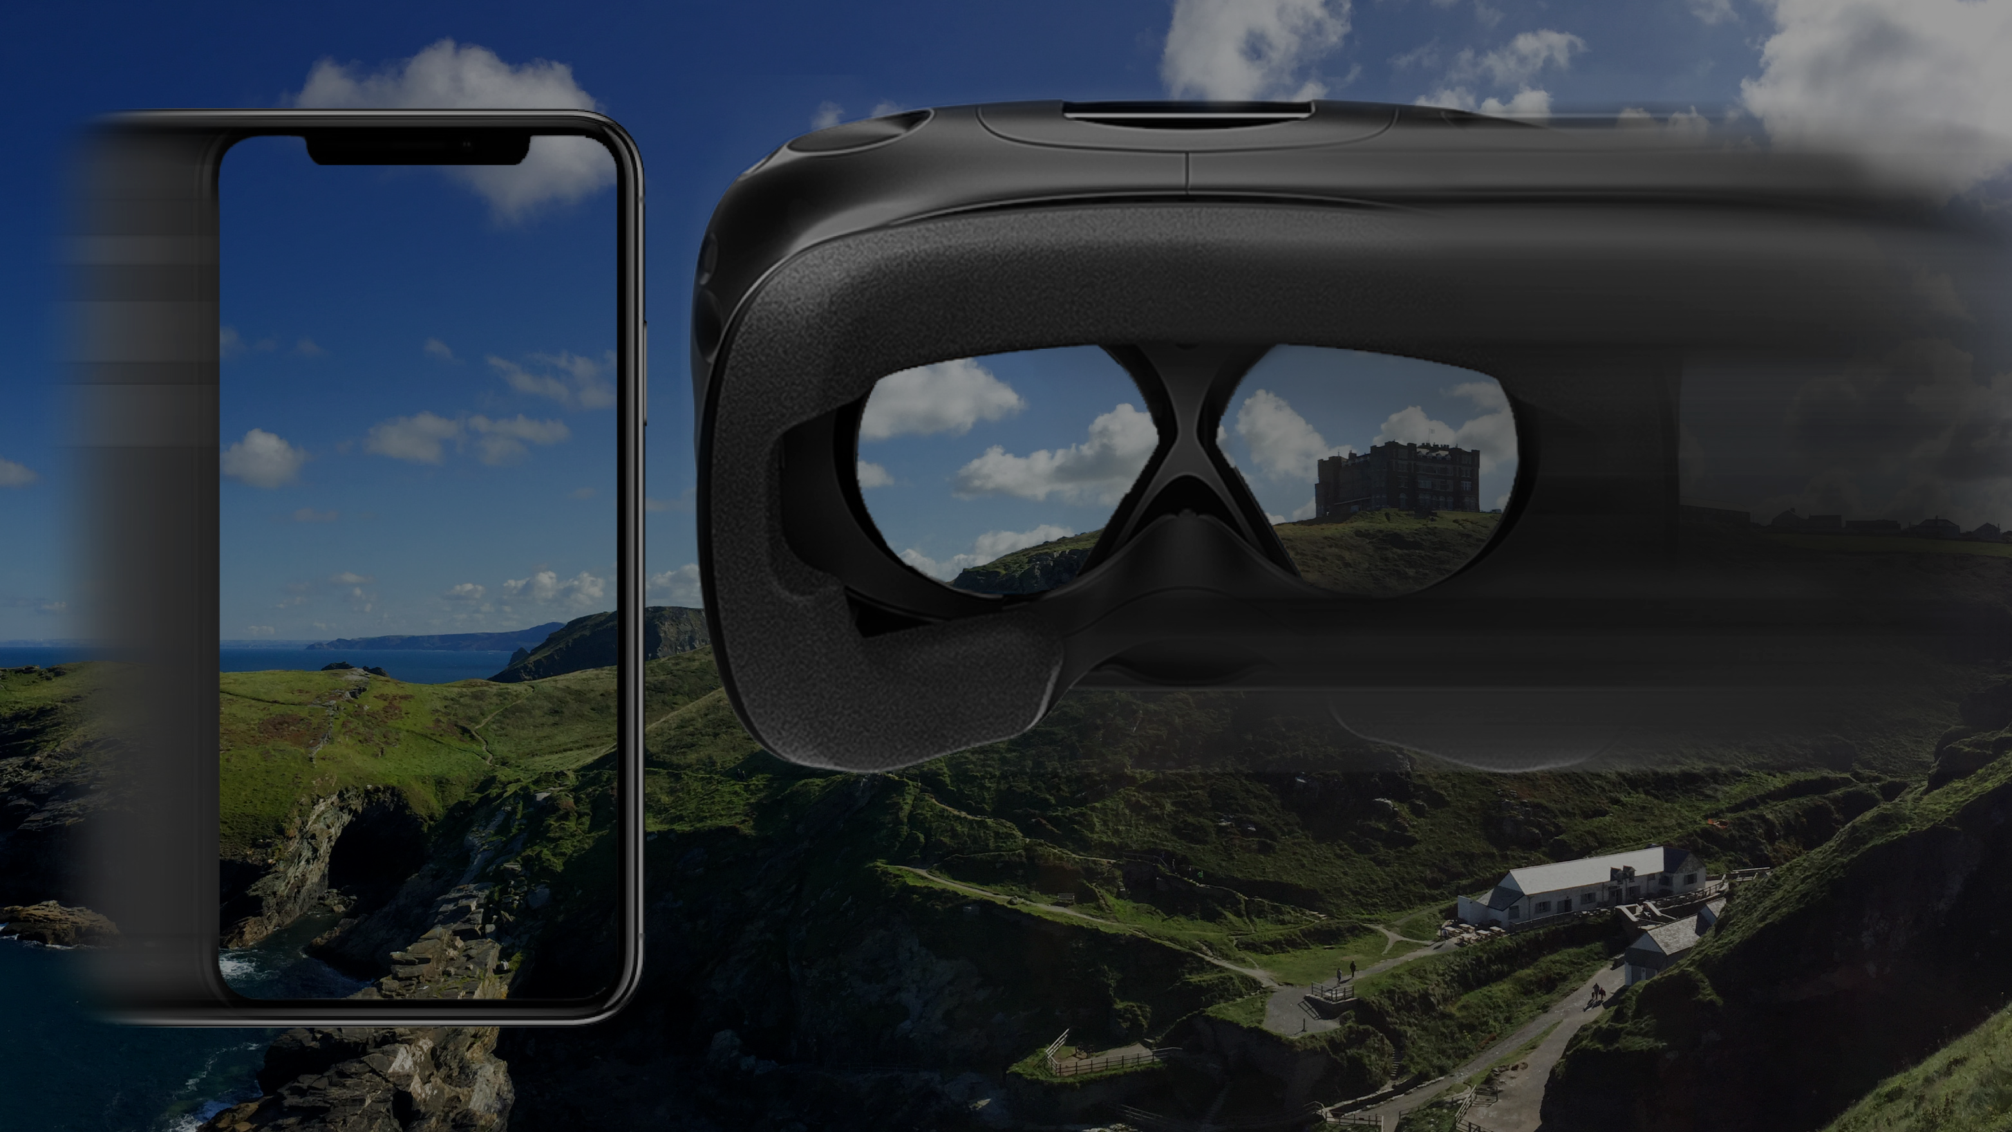
A Brief History of VR Photography + Video
Christian Richardt

Slide 17
Panorama
formed from Greek πᾶν ”all” + ὅραμα “sight”
term coined by painter Robert Barker in 1792
definition: any wide-angle view or representation of a physical space
Panoramic view of London, from the top of Albion Mills, by Robert Barker, 1792
Notes:
Source:
https://en.wikipedia.org/wiki/File:Panorama_of_London_Barker.jpg

Slide 18
The Rotunda in Leicester Square (1793–1863)
Robert Mitchell, 1901
Notes:
By 1793, Barker had built "The Panorama" rotunda at the center of London's entertainment district in Leicester Square, where it remained until closed in 1863.
Cross-section of the Rotunda in Leicester Square in which the panorama of London was exhibited (1801).
Source:
https://en.wikipedia.org/wiki/File:Cross-section-of-the-rotund_0.jpg

Slide 19
Panorama Mesdag (1881)
120 × 14 metres — painted in 1880–1881 by Hendrik Willem Mesdag
Notes:
“Panorama Mesdag gives you a 360 degree vista of the sea, the dunes and the fishing village of Scheveningen as it was in 1881.”
Source:
https://en.wikipedia.org/wiki/File:Panorama_mesdag.PNG

Slide 20
Gettysburg Cyclorama (1883)
115 × 13 metres — painted in 1882–1883 by Paul Philippoteaux
Notes:
“The effect of the painting has been likened to the nineteenth century equivalent of an IMAX theatre.” (https://en.wikipedia.org/wiki/Gettysburg_Cyclorama)
Source:
https://en.wikipedia.org/wiki/File:Paul_Philippoteaux_-_Gettysburg_Cyclorama.jpg

Slide 21
Stereoscopy
Technique for creating or enhancing the illusion of depth in an image by means of stereopsis for binocular vision
from Greek:
στερεός (stereos) — ‘firm, solid’
σκοπέω (skopeō) — ‘to look, to see’
© National Portrait Gallery, London
Charles Wheatstone
(1802–1875)
Notes:
Professor of Experimental /Philosophy/ at King’s College London
inventor, who is best known for his electrical inventions, including the electric telegraph

Slide 22
Wheatstone stereoscope (1838)
© David Tett/King’s College London
Notes:
Wheatstone’s original stereoscope at King’s College London
stereos (Greek) = solid
scope (Greek) = “examine, inspect, look to or into, consider”

Slide 23
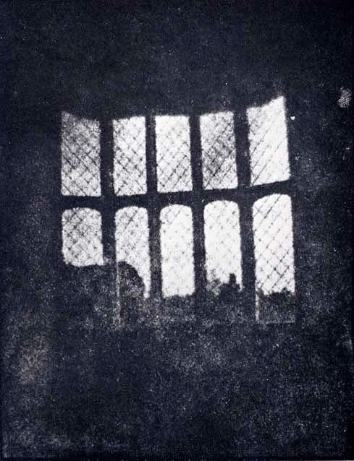
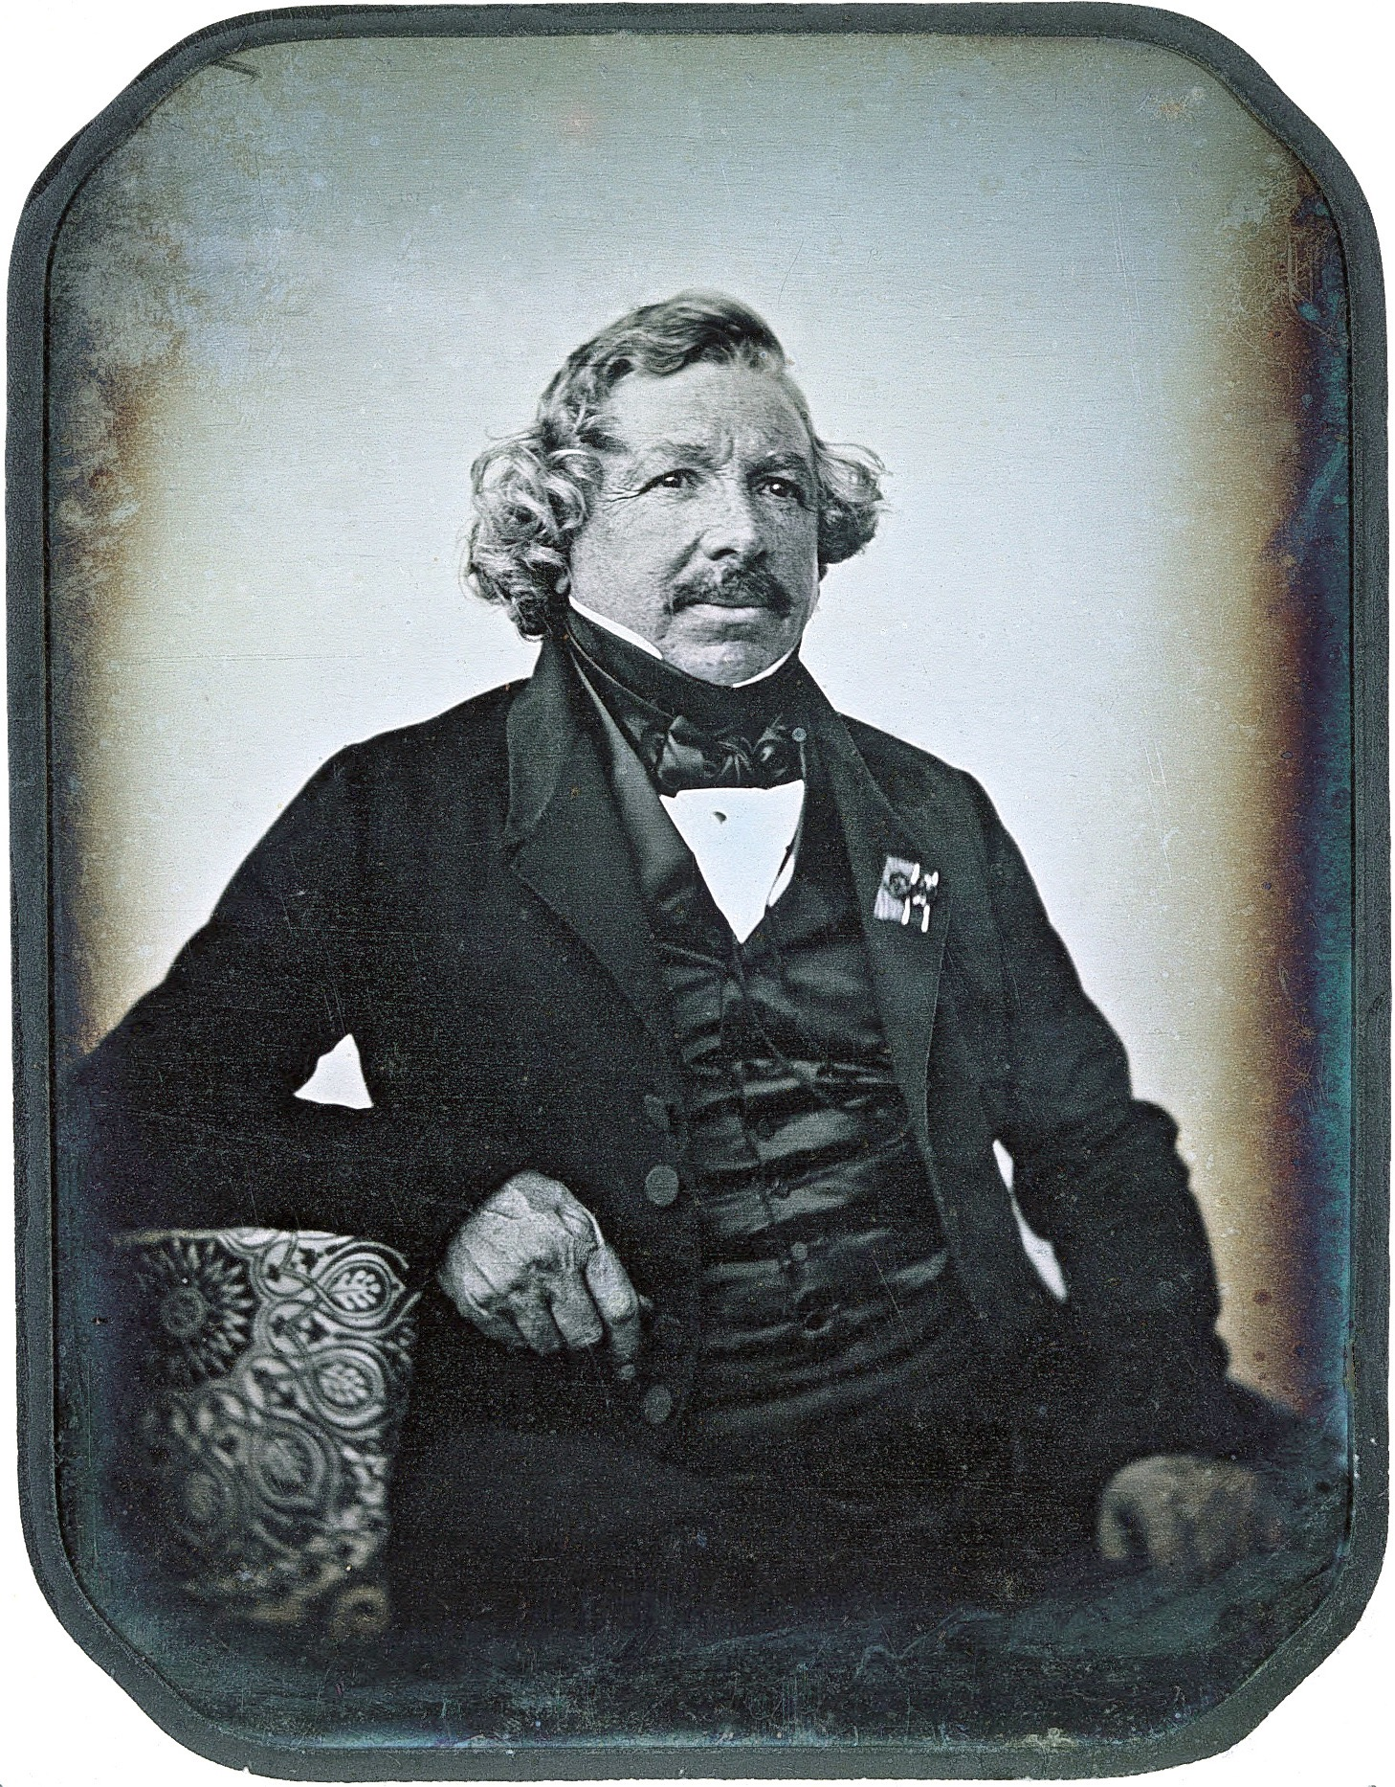
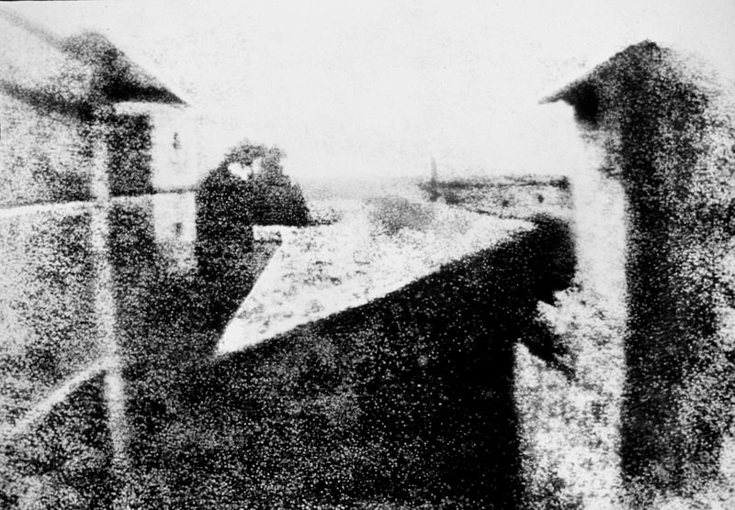
A brief history of photography
1826
First photograph
(Nicéphore Niépce)
1835
First negative
(Henry Fox Talbot)
1839
Daguerrotype
(Louis Daguerre)
Notes:
Nicéphore Niépce (1765–1833), French inventor & inventor of photography.
William Henry Fox Talbot (1800–1877), British scientist, inventor and photography pioneer.
Louis-Jacques-Mandé Daguerre (1787–1851), French artist and photographer.

Slide 24
Wheatstone stereoscope (1838)
© David Tett/King’s College London
Notes:
the other problem … bulky …
Dr Brian May, lead guitarist of Queen and astrophysicist, and a keen stereographer

Slide 25
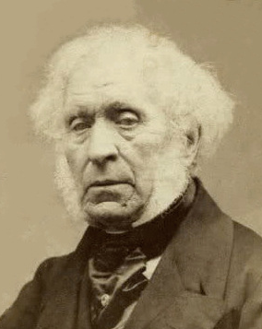
Brewster stereoscope (1849)
© The Bill Douglas Cinema Museum, University of Exeter
David Brewster
(1781–1868)
Notes:
innovation: introduction of lenses
The Brewster Stereoscope was much admired by Queen Victoria when they were demonstrated at the Great Exhibition of 1851.
source:
https://commons.wikimedia.org/wiki/File:David-Brewster.jpg

Slide 26
Holmes stereoscope (1861)
© Berezin Stereo Photography Products
Oliver Wendell Holmes
(1809–1894)
Notes:
physician and poet

Slide 27
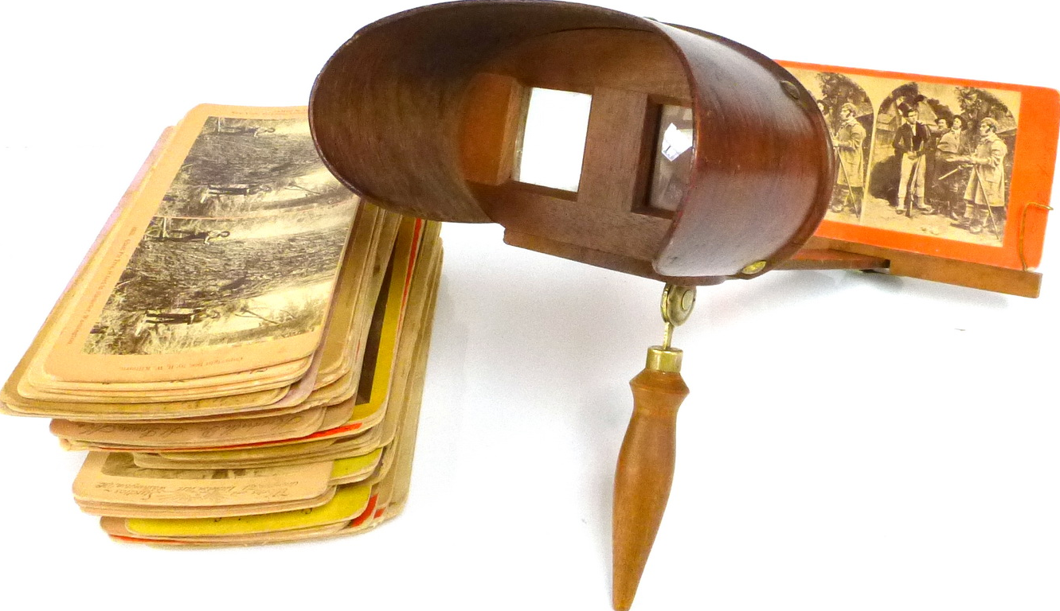
Holmes stereoscope (1861)
© publichistorymuse.wordpress.com
Notes:
lightweight and cheap

Slide 28
Stereo photography = Stereography
(c1868)
© ignomini.com
Notes:
Dallmeyer, c1868, wet plate process
http://ignomini.com/photographica/3dcameradetailpages/Dallmeyer_Sliding_Box/Dallmeyer_Universal_Sliding_Box.html

Slide 29
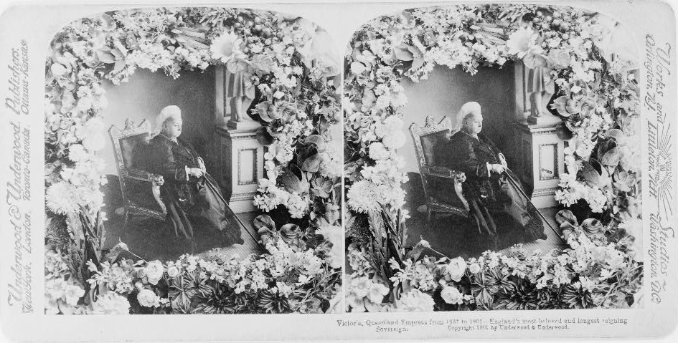
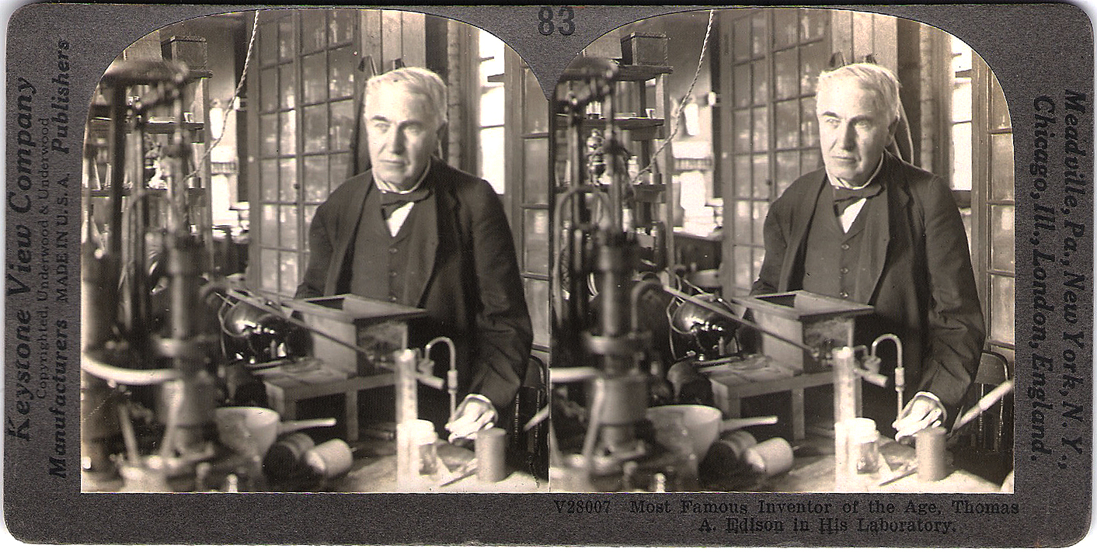
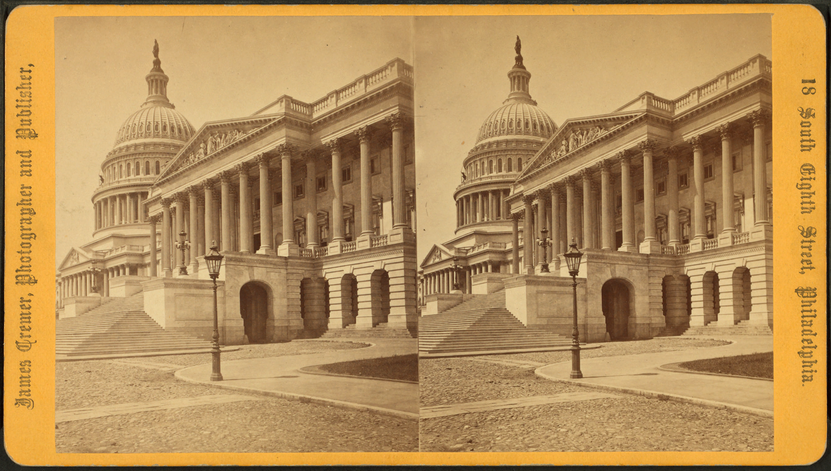
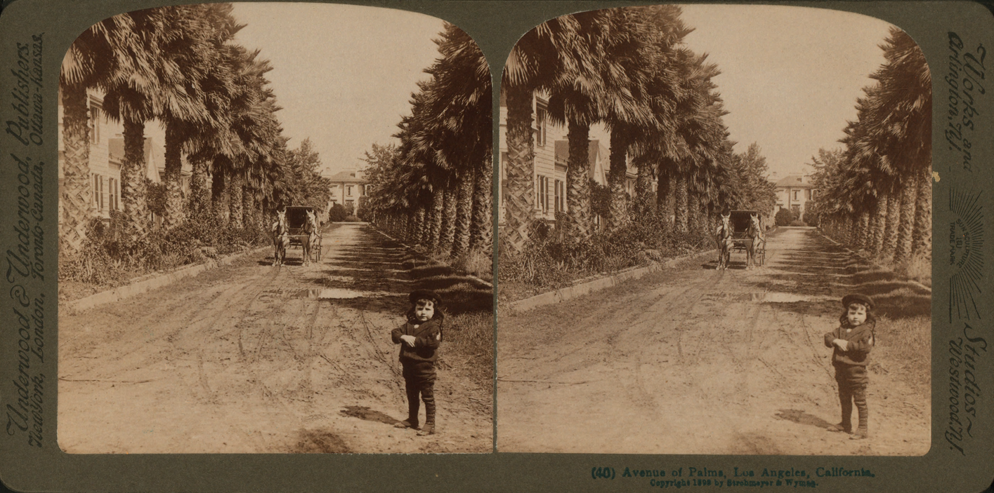
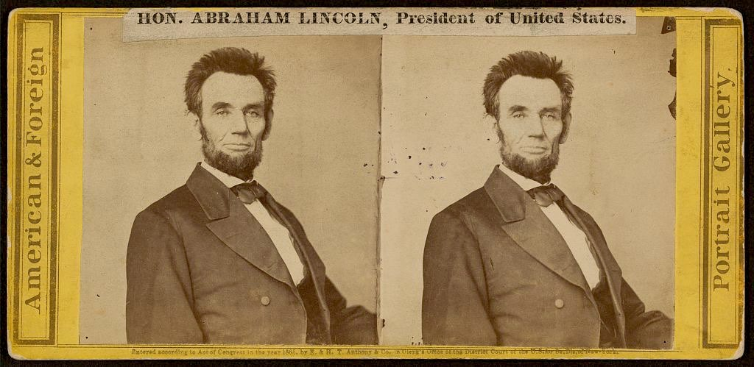
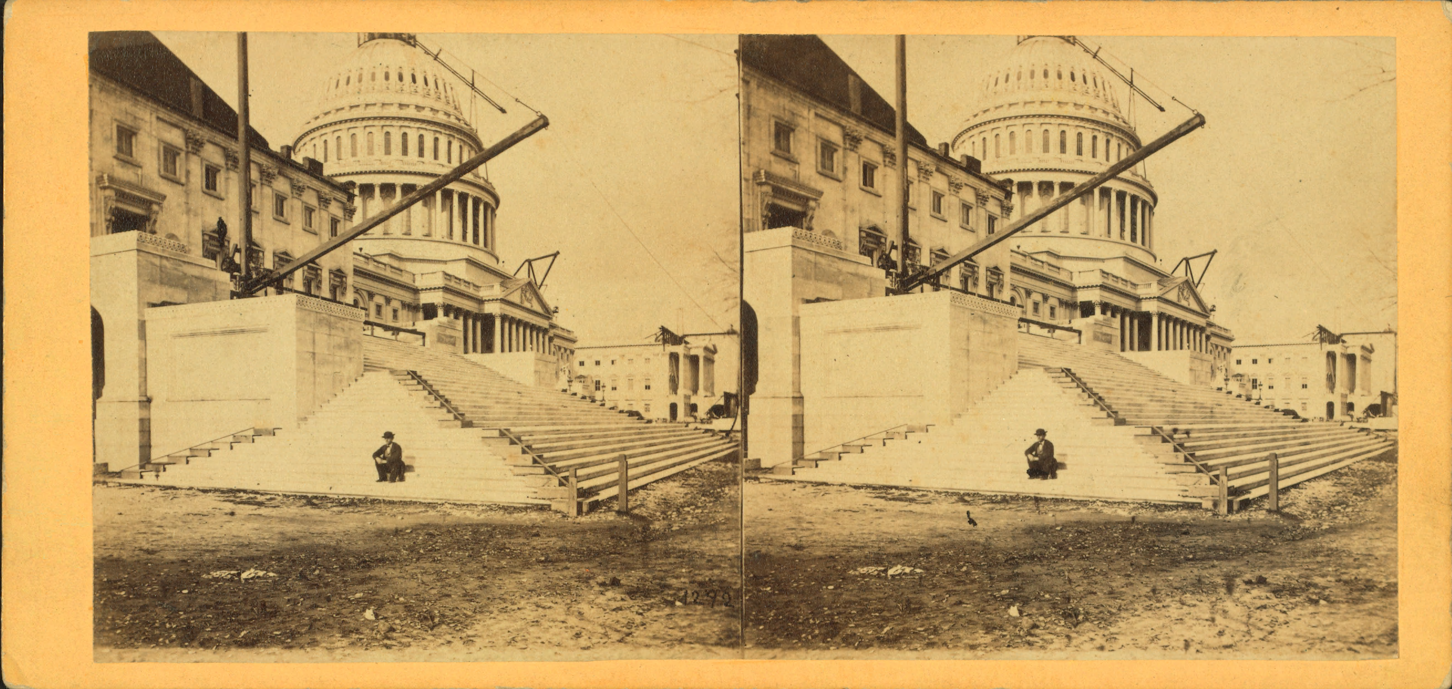
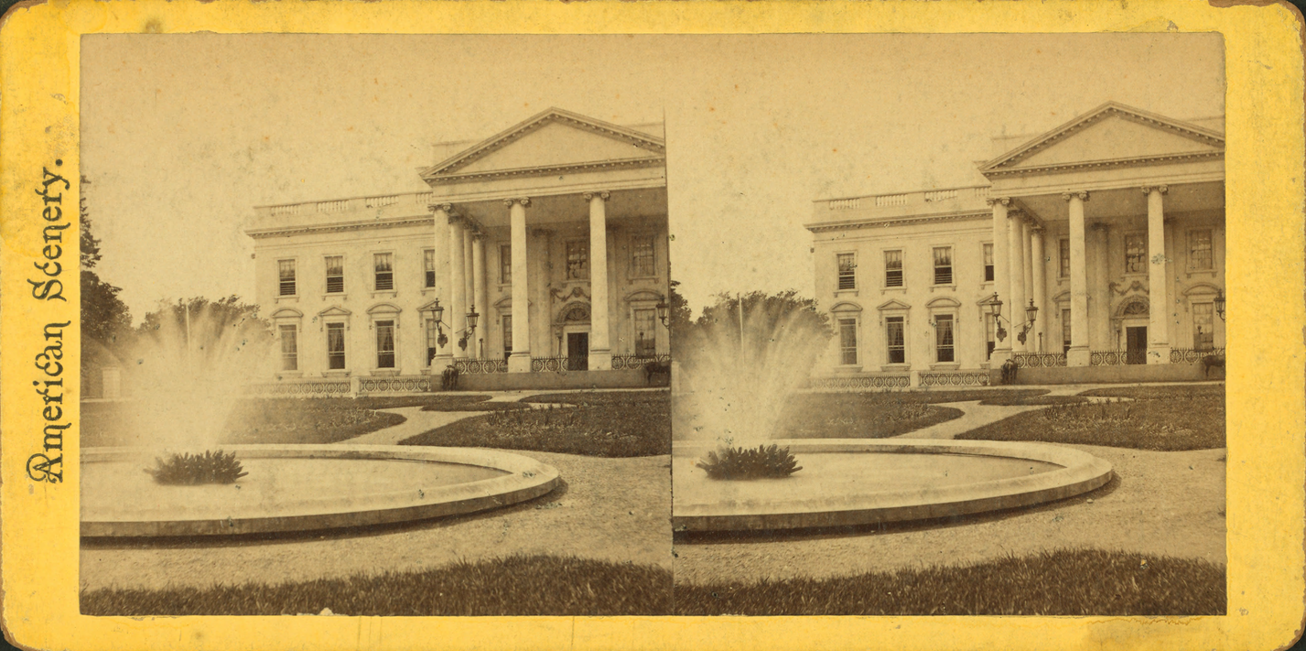
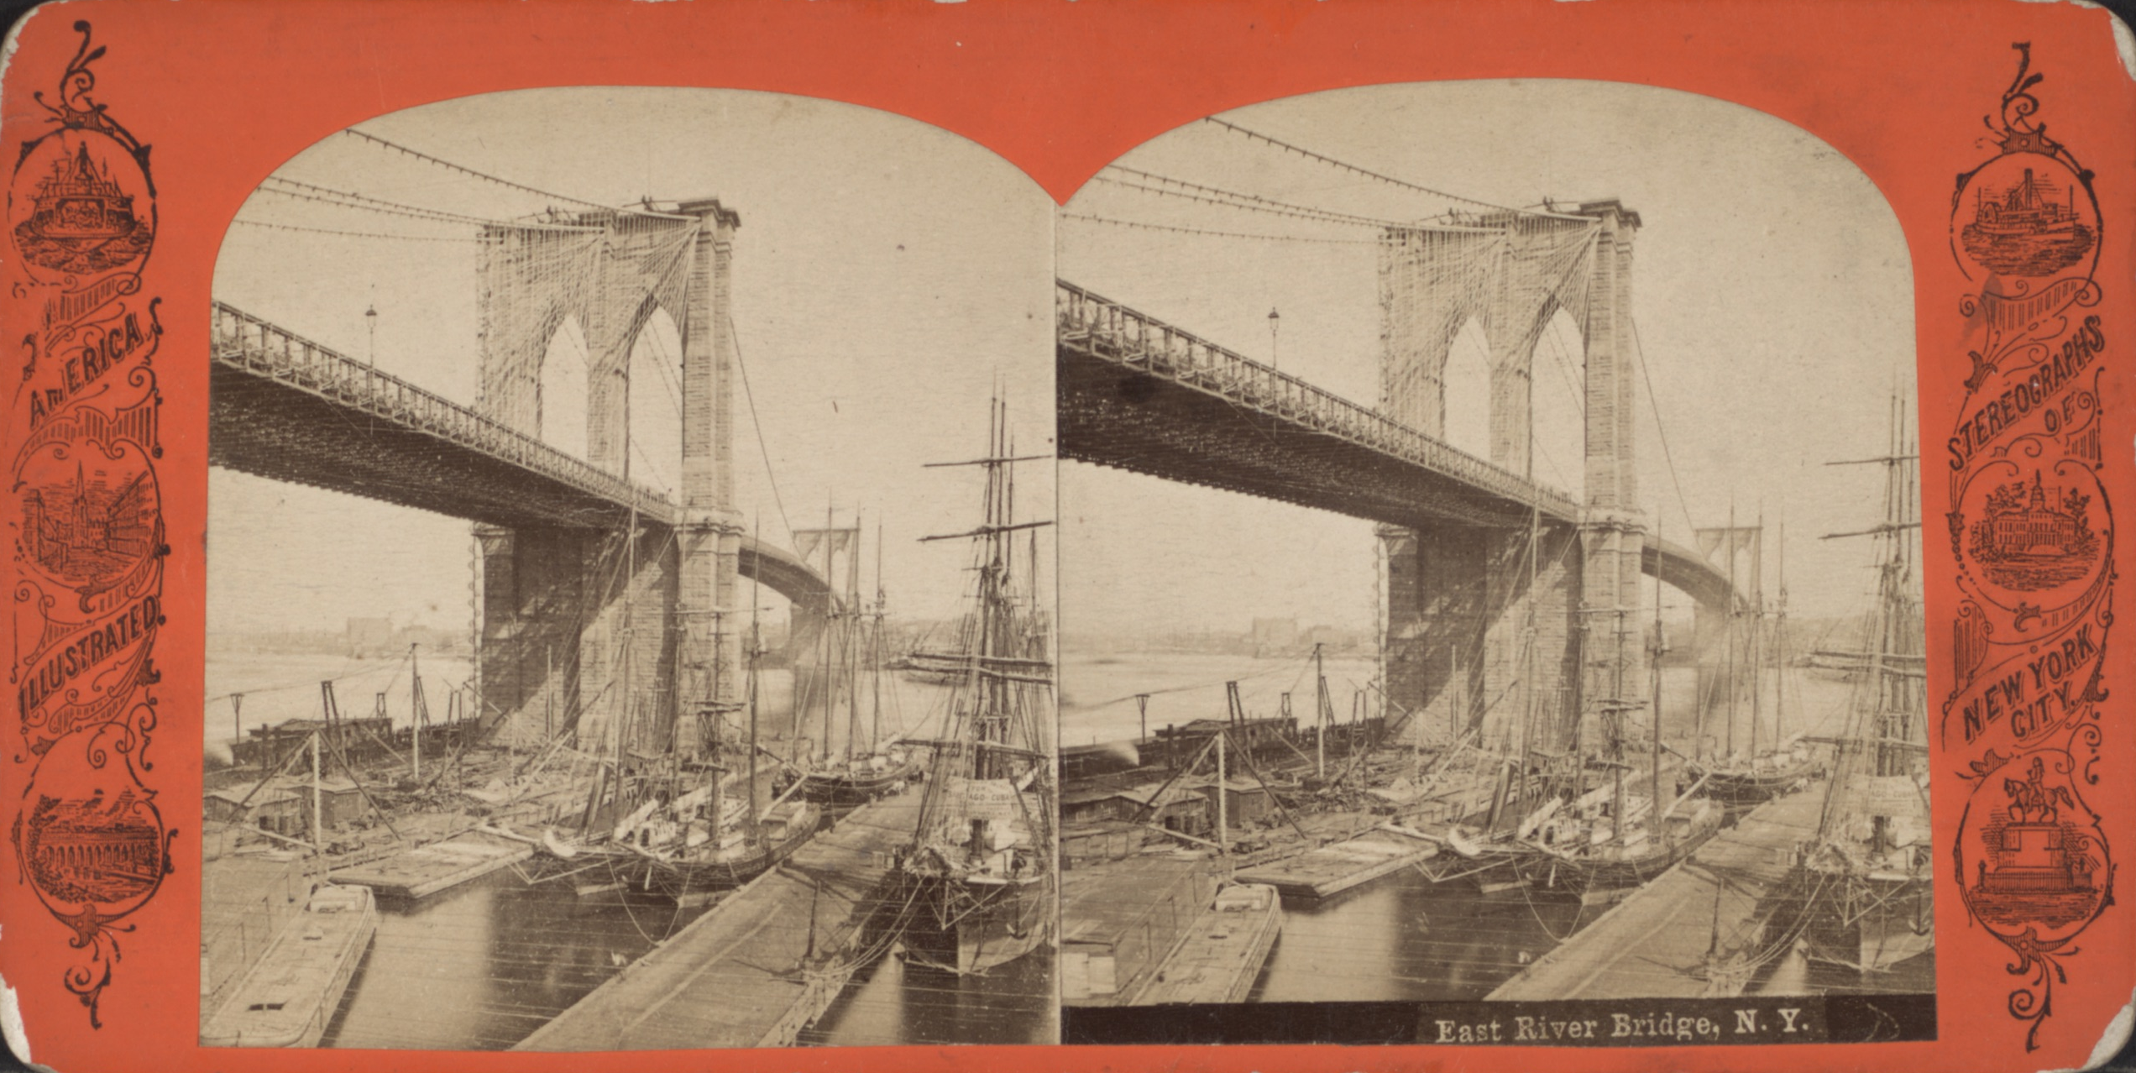
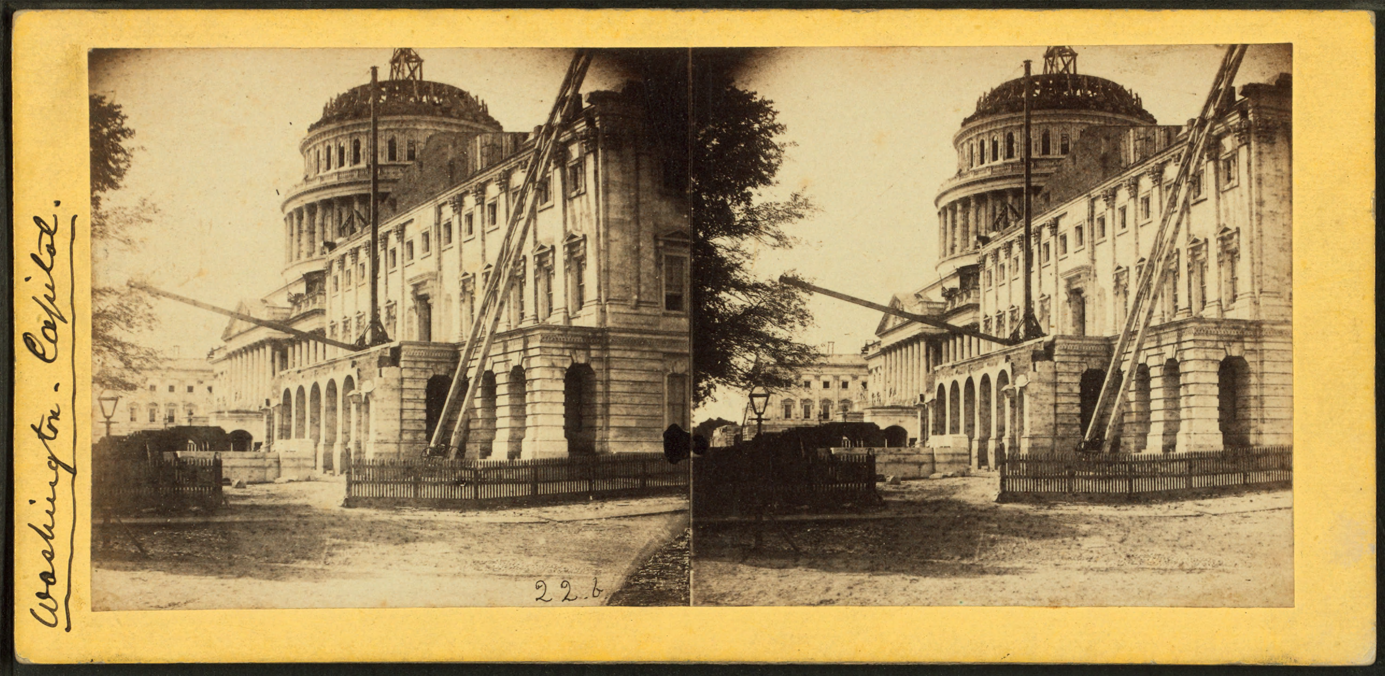
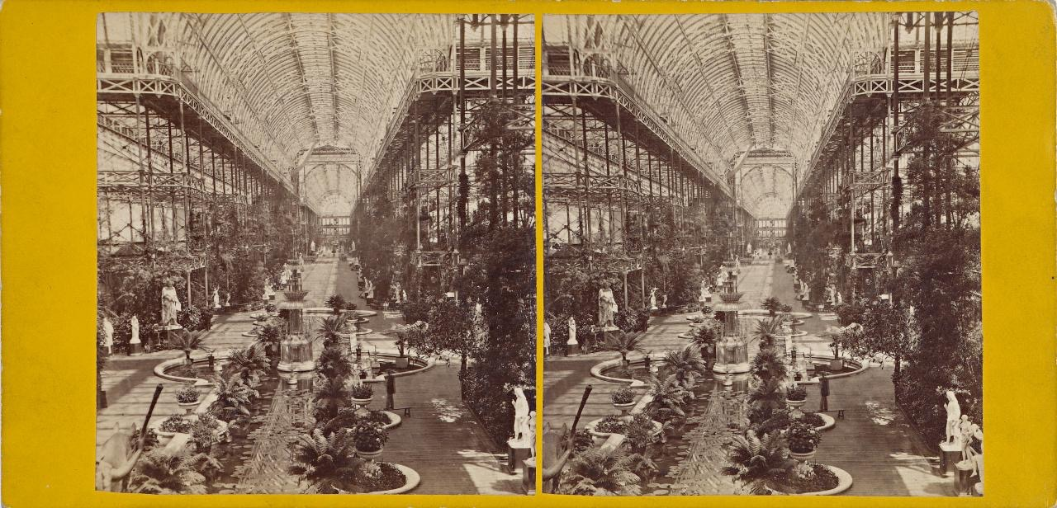
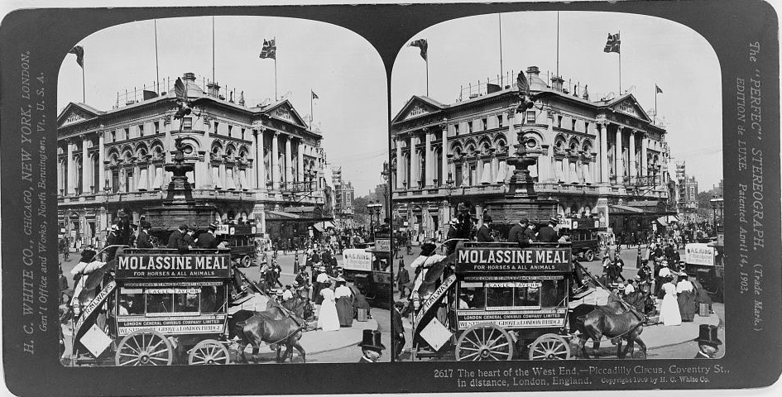
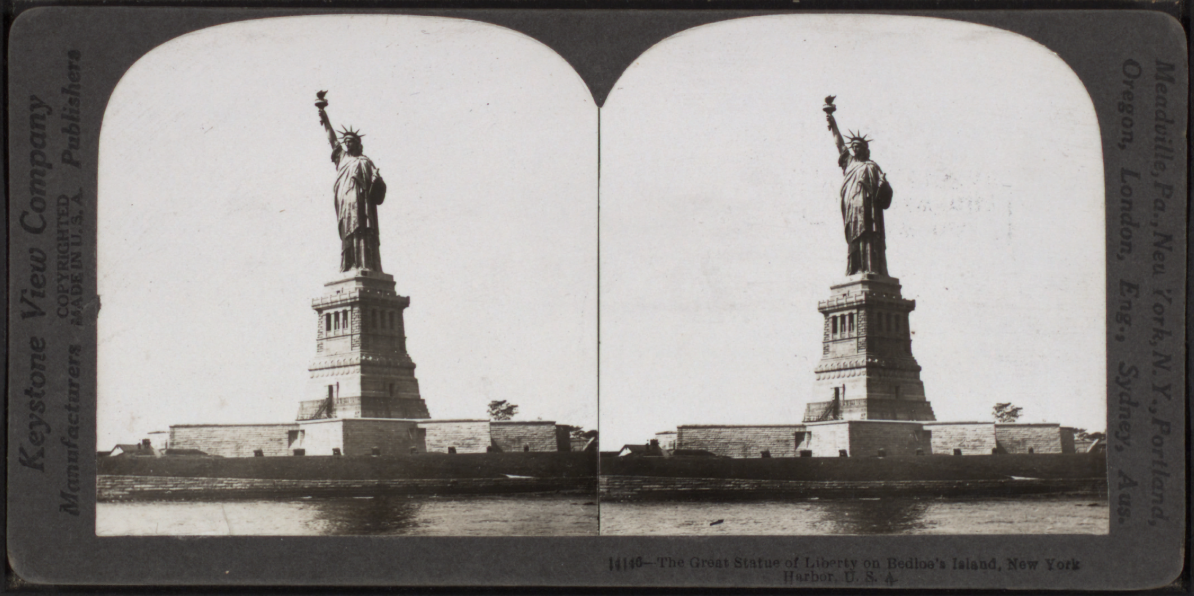
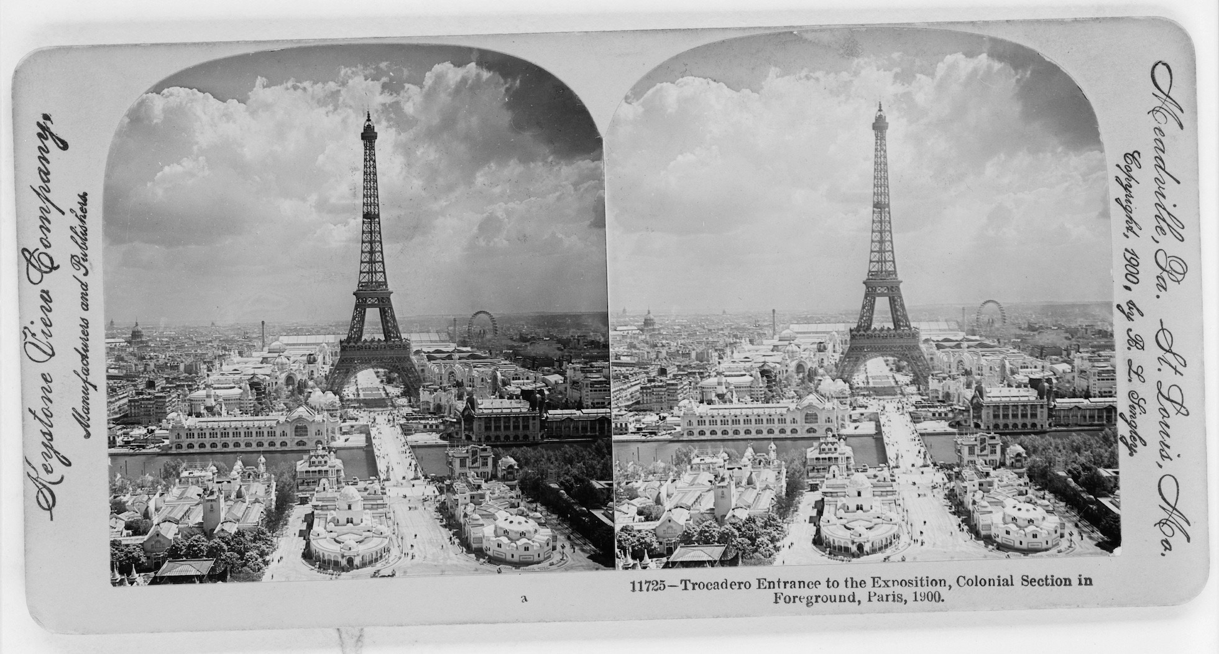
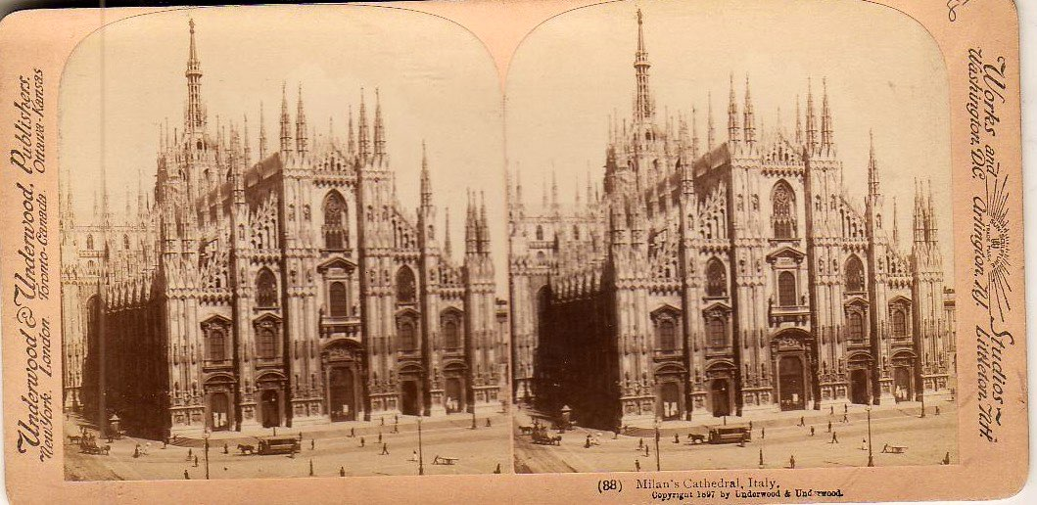
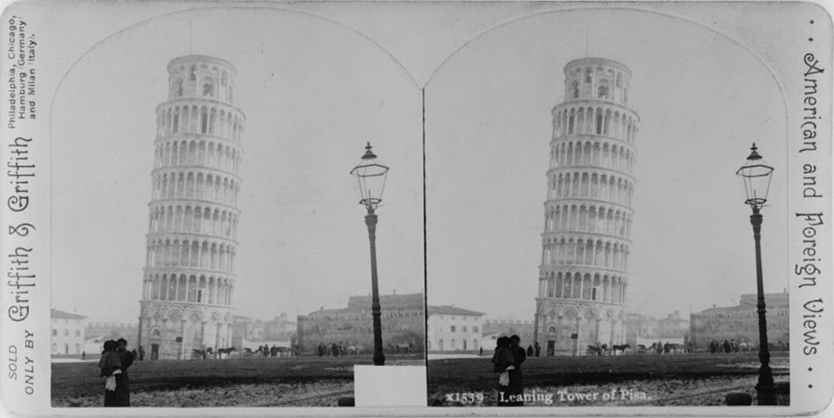
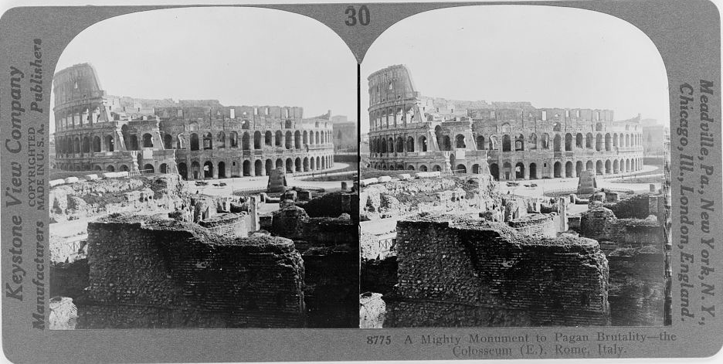
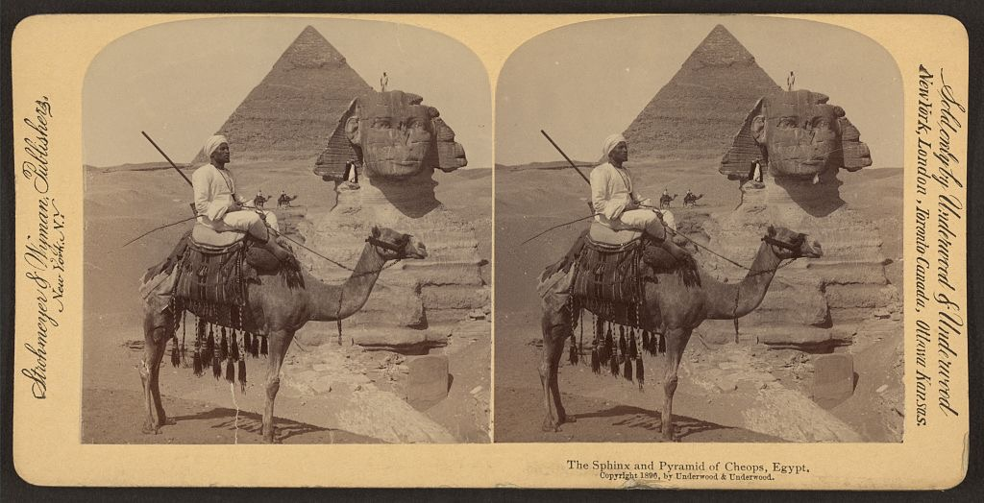
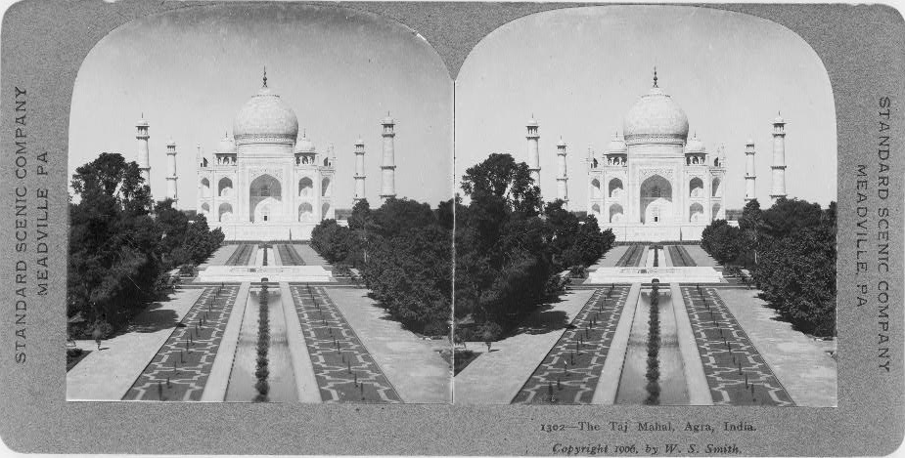
Historical stereographs
Notes:
Crystal palace: 1851

Slide 30
Motion Pictures (1890s)
The U.S. National Archives (1926)
Notes:
1926

Slide 31
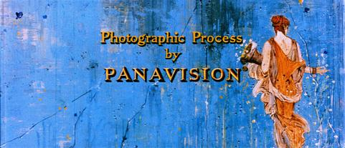
Widescreen motion picture film formats
First success in late 1920s and before 1932 Great Depression:
e.g. NaturalVision, Fox Grandeur, Magnifilm (2:1 aspect ratio)
Warner Vitascope, MGM Realife
Second wave in 1950s and 60s:
Ultra Panavision 70 (2.76:1)
Ben-Hur (1959)
CinemaScope (2.35:1 – 2.55:1)
Lady and the Tramp (1955)
Super Panavision 70 (2.20:1)
2001: A Space Odyssey (1968)
© Buena Vista Distribution
Screenshot of “The Big Fisherman” (1959), the first film released using the Super Panavision 70 process.
Notes:
The Panavision logo incorporates three aspect ratios into its design—4:3 (TV, standard "Academy" ratio) on the inside, 1.85:1 (standard U.S. widescreen) in the middle, and 2.40:1 (modern 35mm anamorphic) on the outside.
Sources:
https://en.wikipedia.org/wiki/File:Panavision3.jpg — © Buena Vista Distribution
https://en.wikipedia.org/wiki/File:Panavision_logo.svg

Slide 32
Multi-projector projection
Cinerama (1952)
Circle-Vision 360° (1955)
3× 35mm projectors
9× 35mm projectors
https://www.themeparktourist.com/
Notes:
Sources:
https://commons.wikimedia.org/wiki/File:How_Cinerama_is_projected.gif
https://madchatters.net/show-notes/shows-5-14/ (https://madchattersdotnet.files.wordpress.com/2014/12/2014-09-15-13-26-53.jpg) The Mad Chatters
https://www.themeparktourist.com/features/20140316/16850/disneys-secret-plan-revolutionize-cinema-using-disneyland-technology

