Slide 1
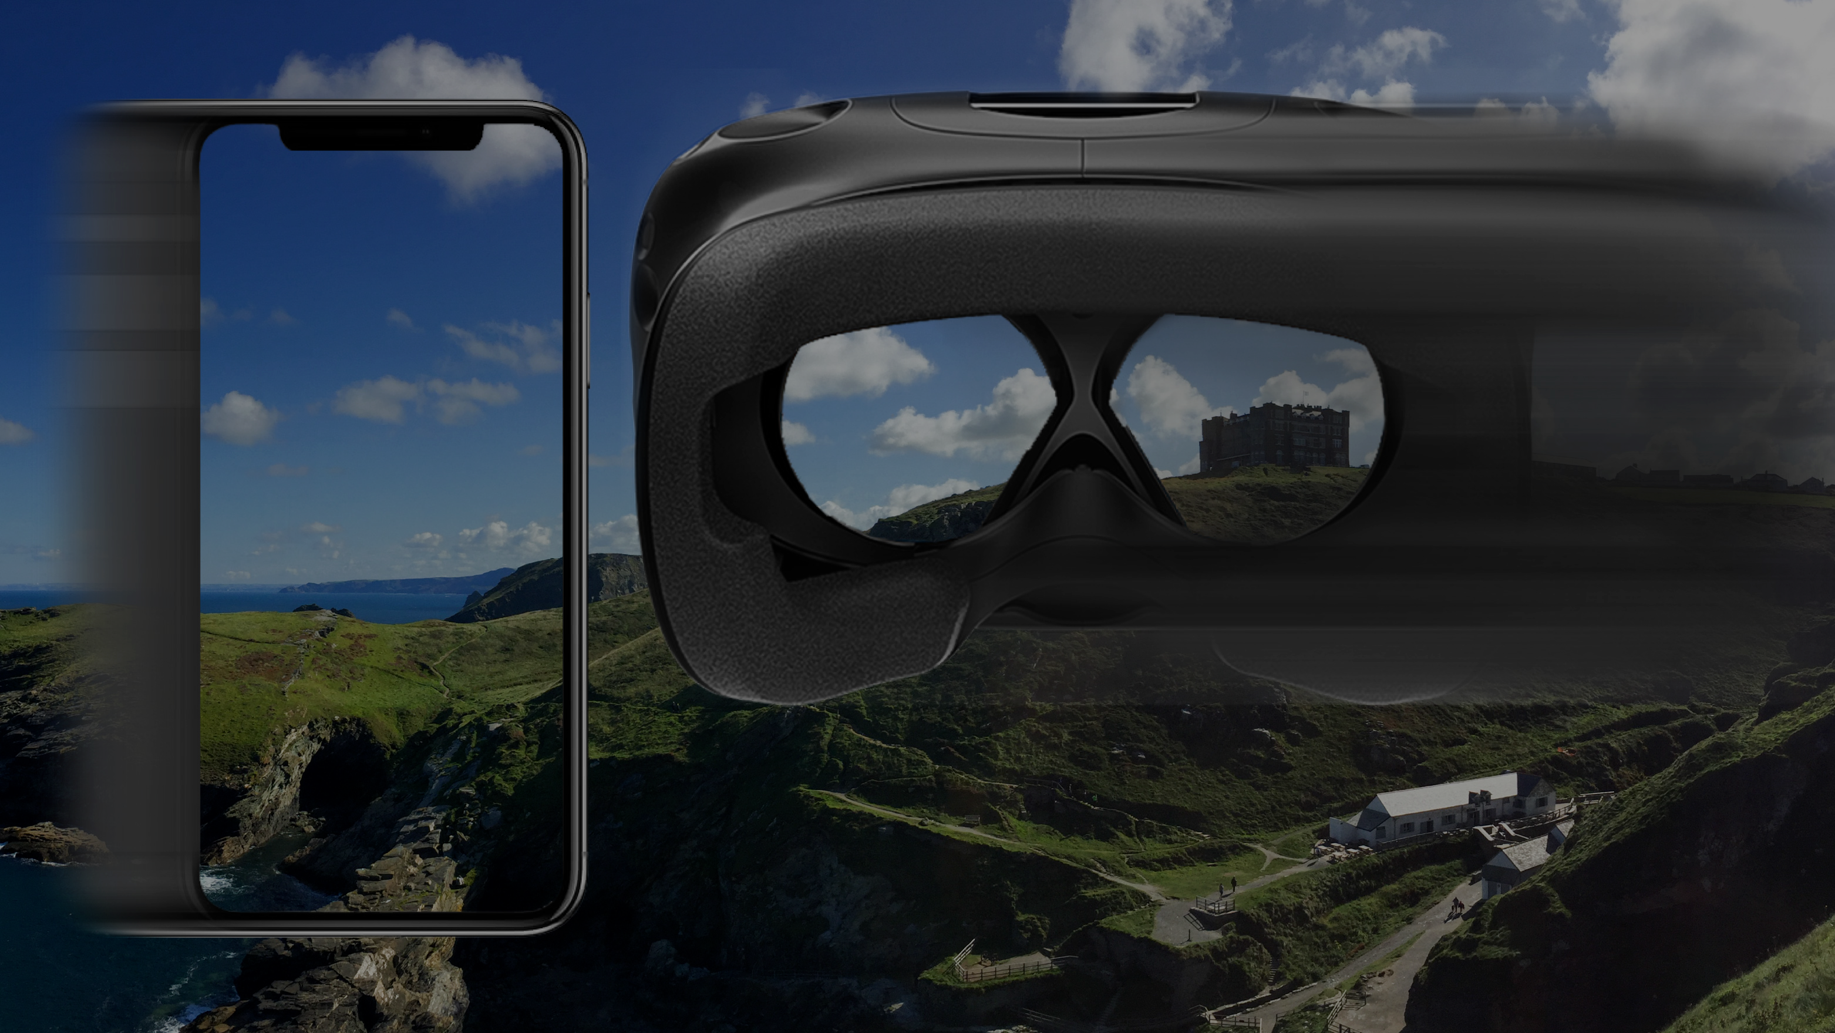



Course Conclusion
Christian Richardt
Notes:
And this brings us towards the end of our course.
In the last three hours, we have seen the latest advances in VR photography and VR video.

Slide 2
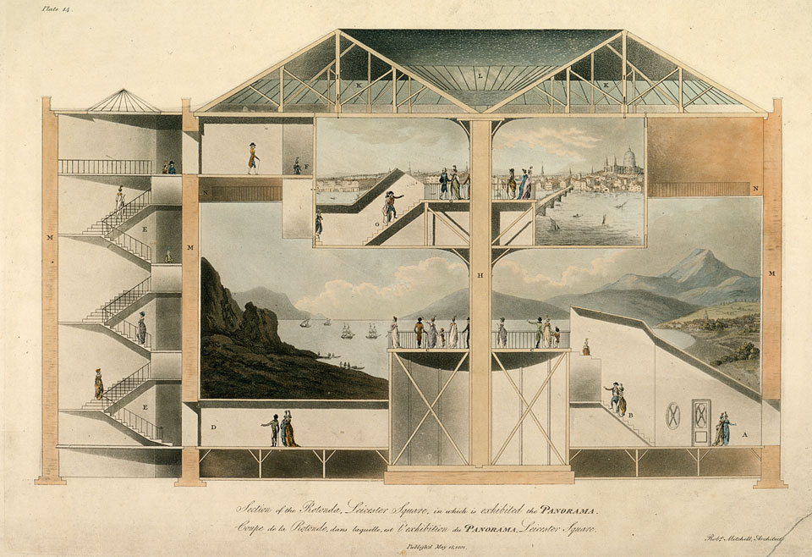
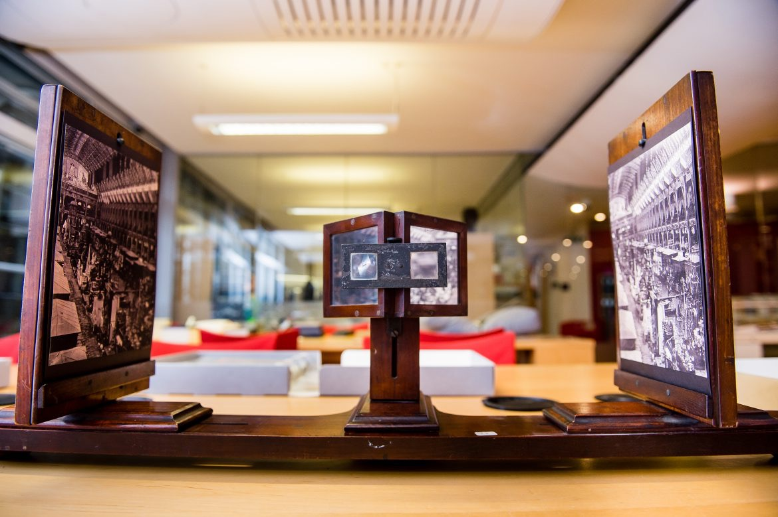
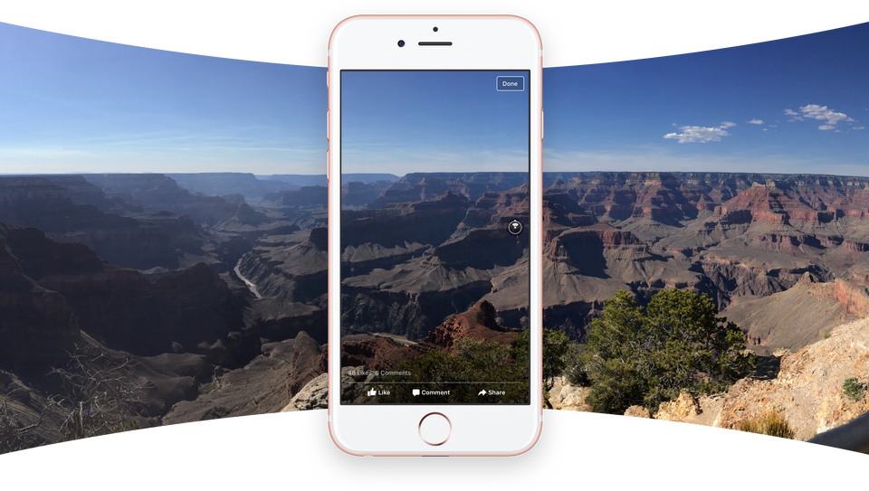
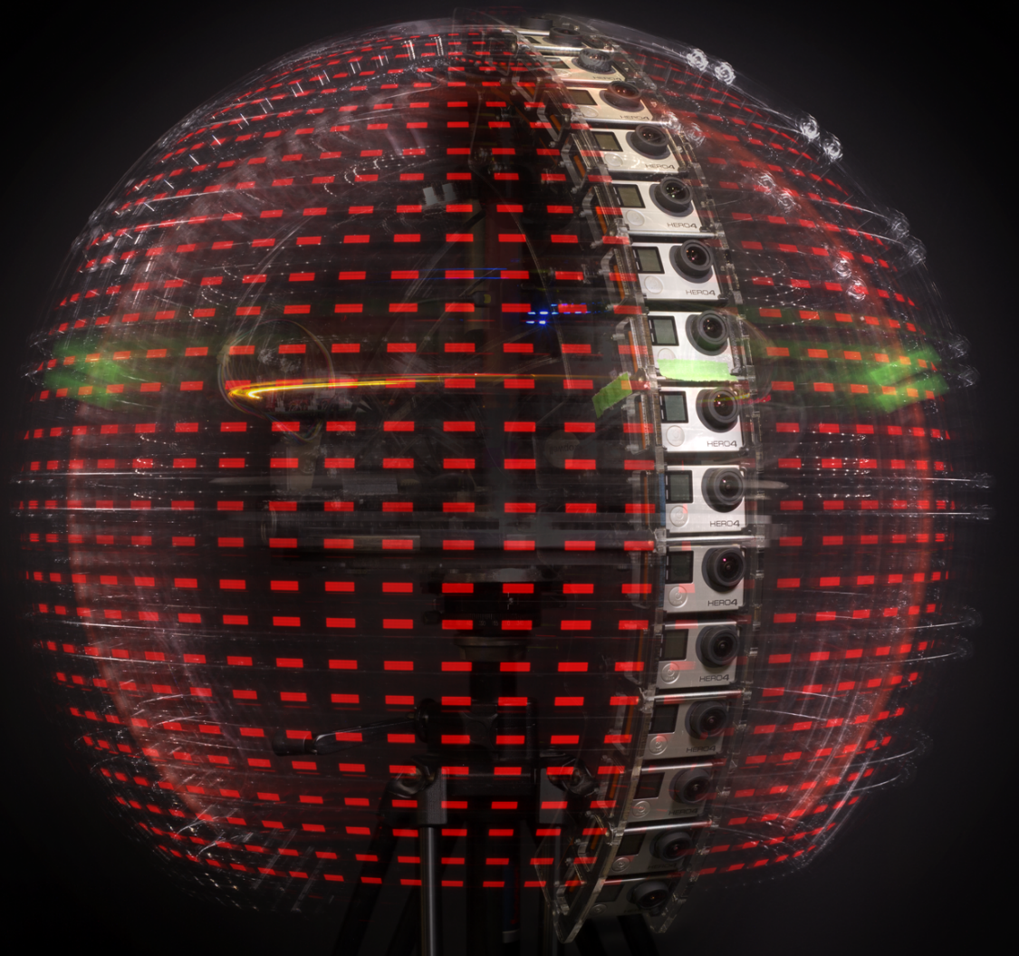
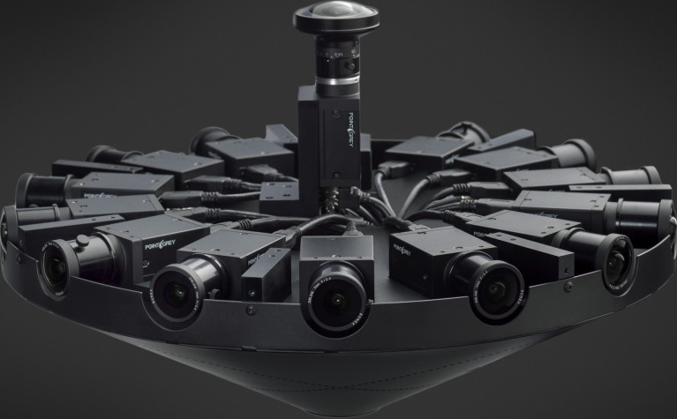
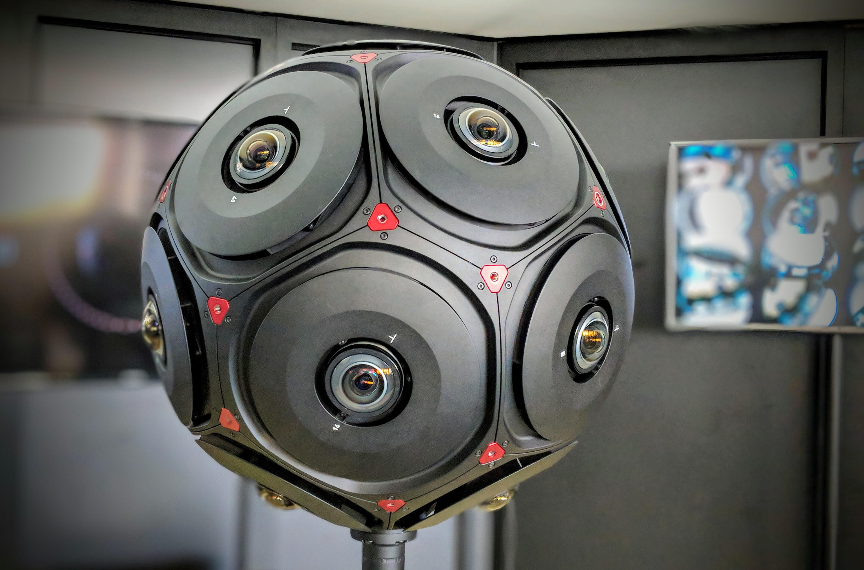
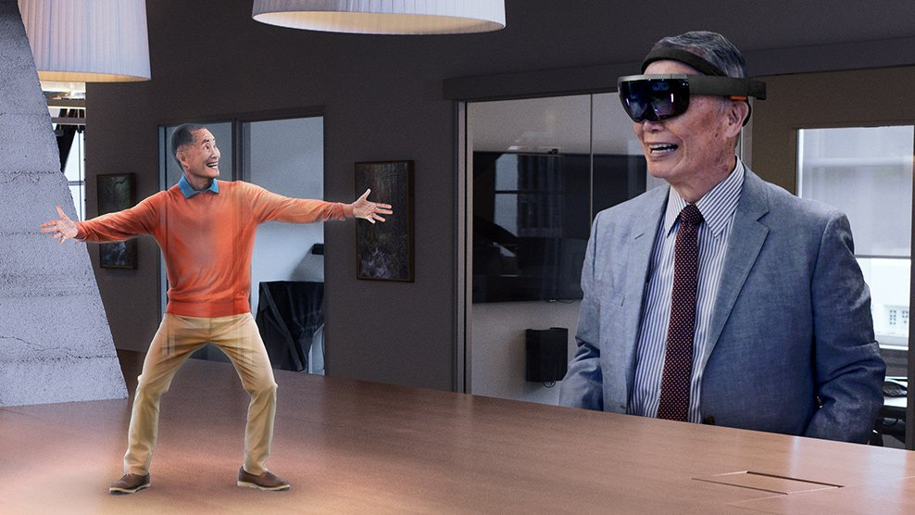
Visual summary
Robert Mitchell, 1901
David Tett/KCL
Facebook
Hedman et al., 2018
Overbeck et al., 2018
Facebook
Konrad et al., 2017
CNET/Facebook
Microsoft
Notes:
We started with a brief excursion into the history of @ panoramas and @ stereoscopy, which reaches back all the way into the late 1700s.
…

Slide 3

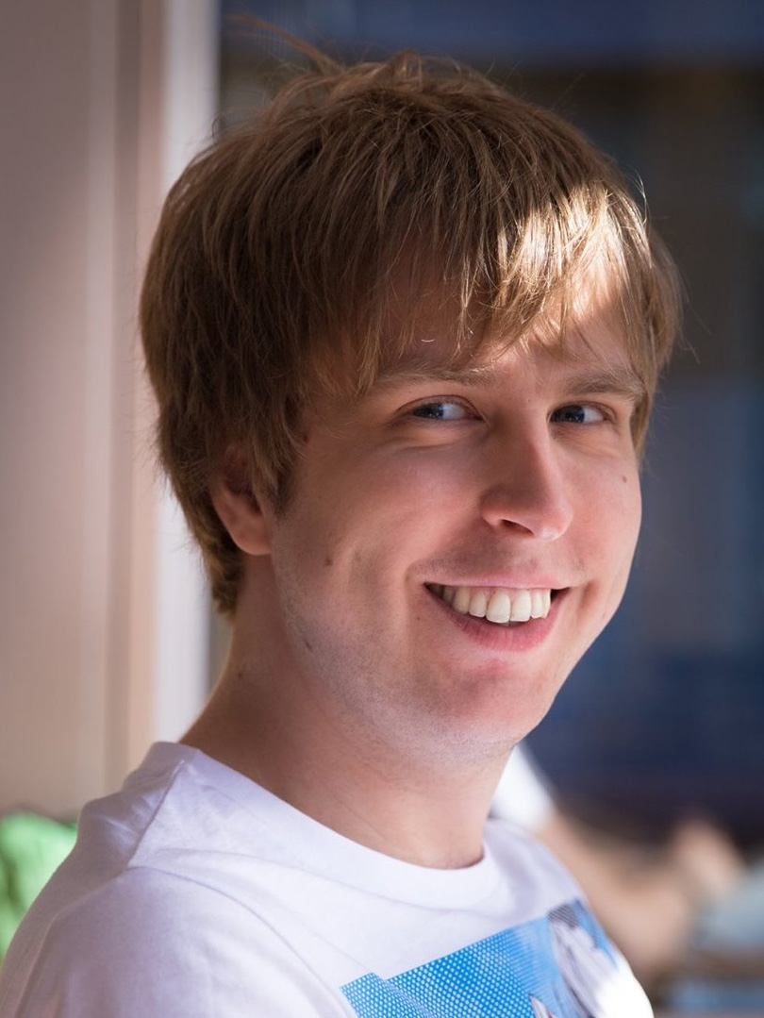


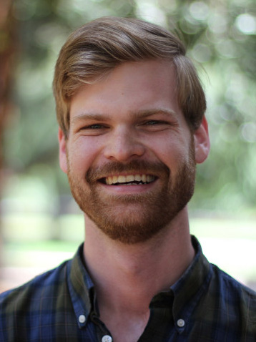
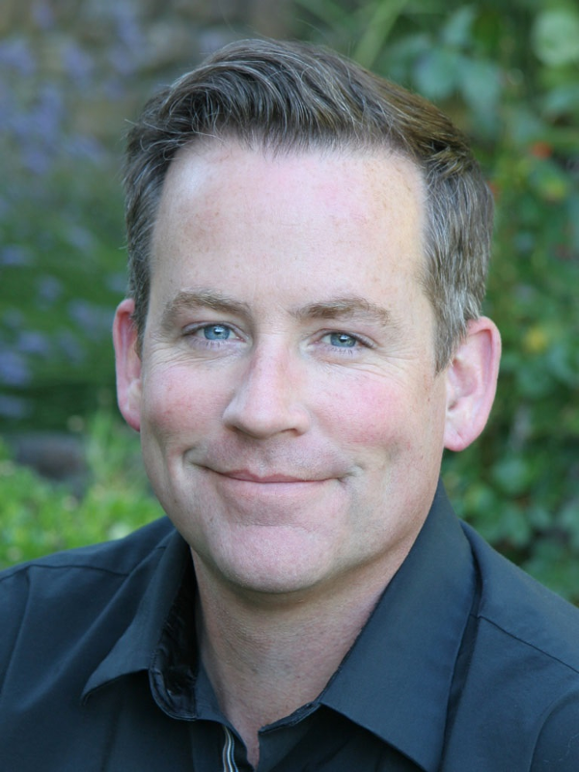





Asking our Team
Christian Richardt
Peter Hedman
Ryan S. Overbeck
Brian Cabral
Robert Konrad
Steve Sullivan
Notes:
This is the part where you ask us questions
And while you think of which burning questions you would like to ask us, I will get started with my own question

Slide 4
What single thing would most improve
VR photography or VR video?

Slide 5
“I guess the single biggest thing that is missing from cinematic VR currently is supporting 6DOF.
The difference in experience in going from a single viewpoint to allowing for translations is huge.
After that I think real-time streaming of content and supporting focus cues would be the two next most important considerations.”
Robert Konrad

Slide 6
“From my perspective doing volumetric,
I’d answer in two parts:
more syncable camera options
(to speed innovation in capture systems)
more support from large-scale social platforms (to reduce consumption friction and speed adoption)”
Steve Sullivan

Slide 7
“A benchmark dataset for VR multi-view stereo (MVS). If we had a 3D reconstruction benchmark […] for VR capture, it would encourage research into robust MVS algorithms that could be used in any VR capture system.
A robust solution to narrow-baseline SfM would be incredibly useful for hand-held capture, facilitating even easier capture with a larger variety of cameras and lenses.”
Peter Hedman

Slide 8
“We need to build a sustainable flywheel for VR photo and video content. This is a bit of a cop-out on the “single thing” part of the question because we need to improve the whole chain.
We need faster and better capture methods and editing workflows, we need more quality content, we need high quality distribution platforms with solid monetization, and, of course, we need more consumer headsets in the wild.”
Ryan S. Overbeck

Slide 9
“We talk a lot about the crossing the ‘uncanny valley’ that limits model based VR capture.
I claim there is a ‘artifact barrier’ limiting model free capture such as presented in this course.
If we could just capture the 3D scene or lightfield without artifacts as we do 2D videos we would have a much wider and quicker adoption.
Crossing that barrier is the THE challenge that is holding back VR video capture.”
Brian Cabral

Slide 10
“We need new, improved algorithms that can reconstruct dynamic 360-degree environments from multiple video streams to produce lifelike 6-DoF renderings in real time.
Overall, the entire VR video pipeline, from high-quality 360-degree environment video capture, over reconstruction and processing, to rendering and display in 6DoF with light field displays requires more research and engineering.
Christian Richardt

Slide 11
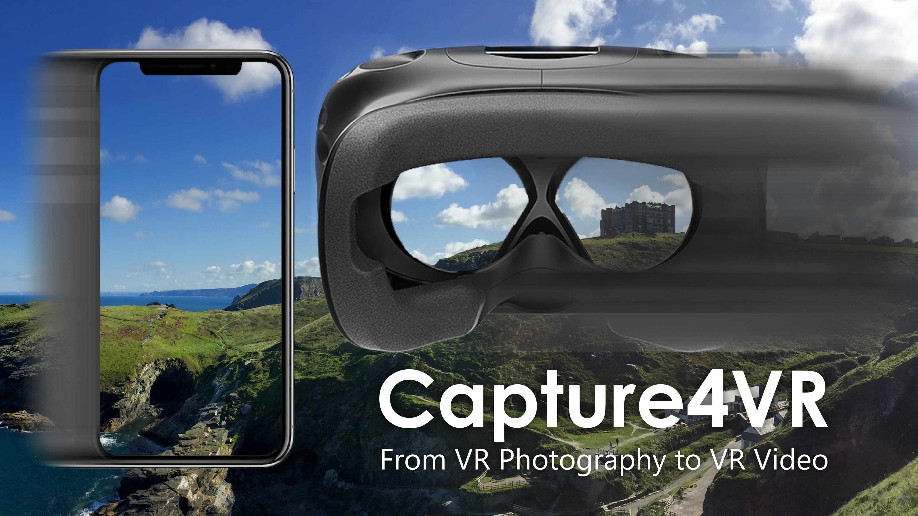

Thank you!
Questions?
richardt.name/Capture4VR

